Slide 1
Social Photo Collage
For iPad

Slide 2
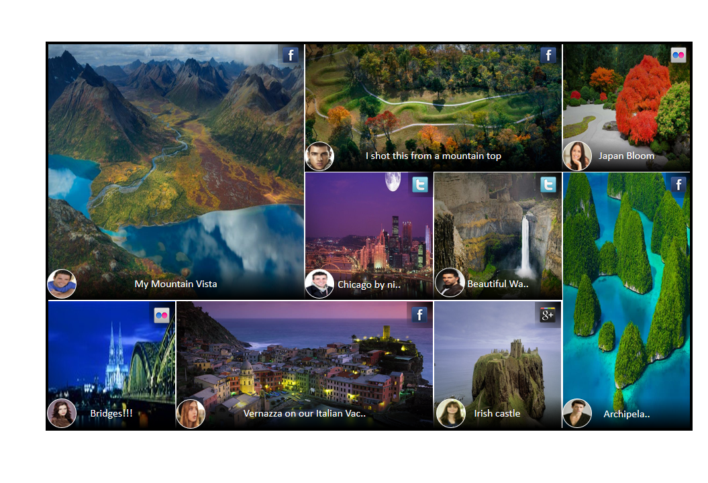
Main Screen

Slide 3
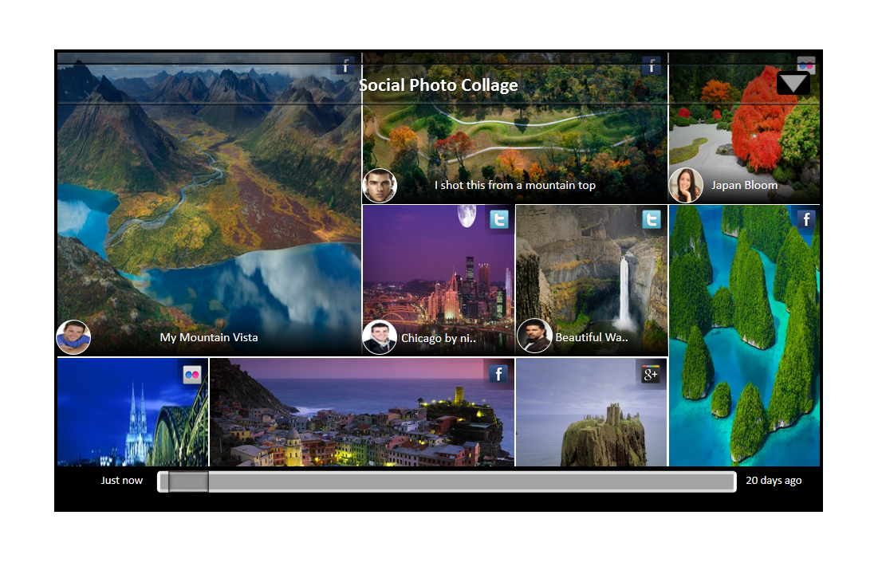
Controls – will be available when user swipes up/down with 2 fingers
Photo Services
Settings

Slide 4
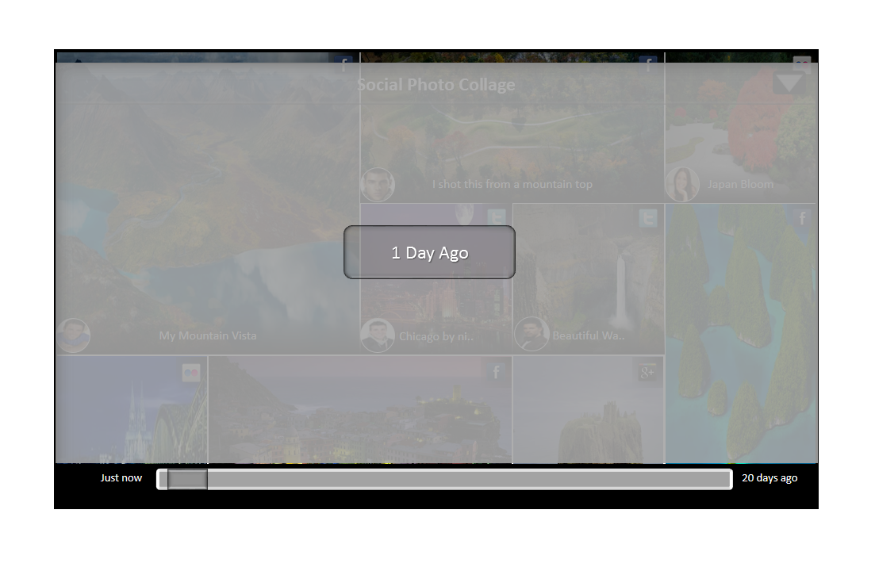
Feed Scrubbing – when the user moves the slider at the bottom

Slide 5
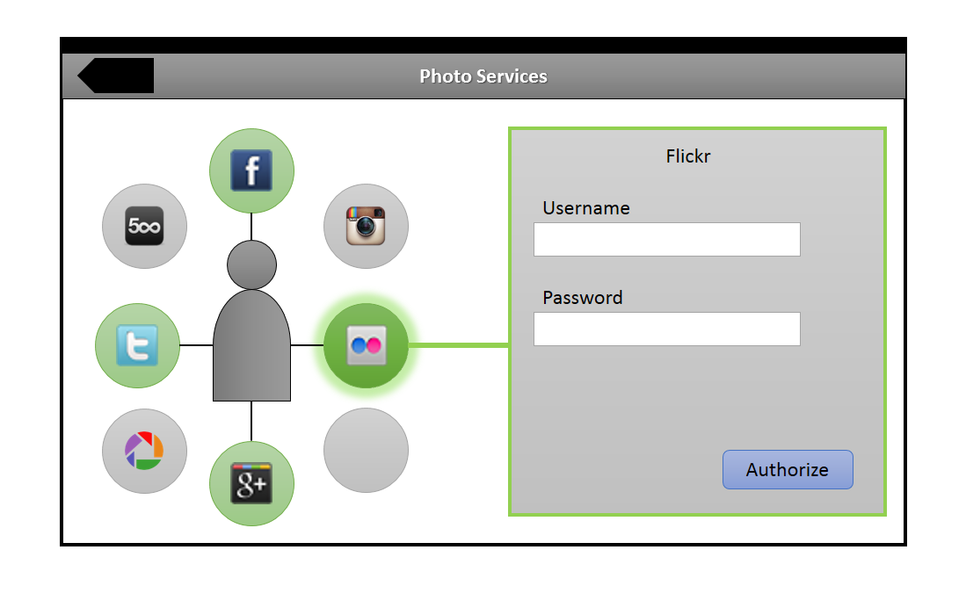
Add a photo services – previously added services will be green. Currently selected service will glow and the oAuth page will be displayed

